Slide 1



Sales Update Analysis
From :
September 2016 – February 2017

Slide 2
OVERVIEW
THE FULL PICTURE FROM THE SALES UPDATE
WHAT ARE THE ODDS ?
Based from the findings
GENERAL RECOMMENDATIONS

Slide 3
OVERALL REVENUE & UNIT SOLD

Slide 4
THE ODDS
Why is product A's market share low, while product A has the lowest average price with a high variety of products?
Why product B has a low basket size but got the highest market share ?
Why is the gap between supermarket west and other supermarkets so significant?

Slide 5

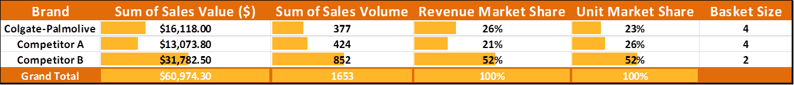
MY FINDINGS
Product B is good at spreading product variations across several supermarkets.
Meanwhile, Colgate and product A only rely more on West and North supermarkets
It takes us back to

Slide 6
CONCLUSIONS AND SUGGESTIONS
COLGATE AND PRODUCT A SHOULD INCREASE THE DISTRIBUTION OF PRODUCT VARIATION IN OTHER SUPERMARKETS
(BY INCLUDE THEIR TOP SALE ITEMS)
COLGATE HAS SPECIAL ATTENTION BY SOME REGULAR CUSTOMERS
(EVEN THOUGH IT IS THE MOST EXPENSIVE PRODUCT WITH LITTLE PRODUCT VARIATION)
START LOOKING AT SOUTH-EAST SUPERMARKET TO EXPAND THE MARKET ??

Slide 7
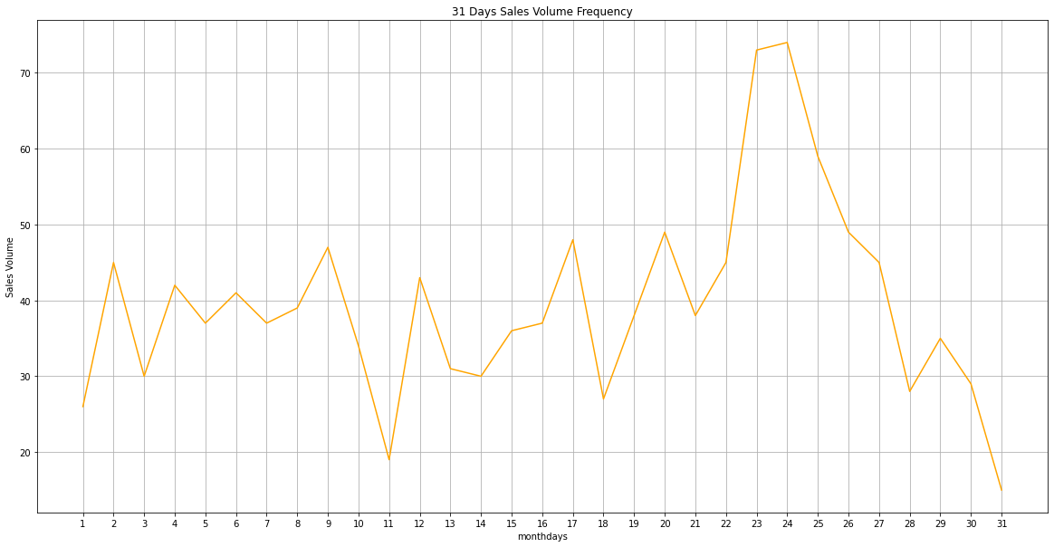
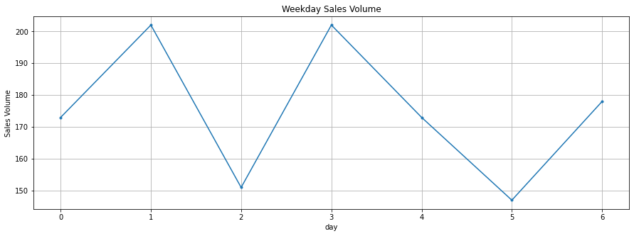
ADDITIONAL FINDINGS
frequency of customers buying products
within 31 days

Slide 8
THANK YOU

